Slide 1
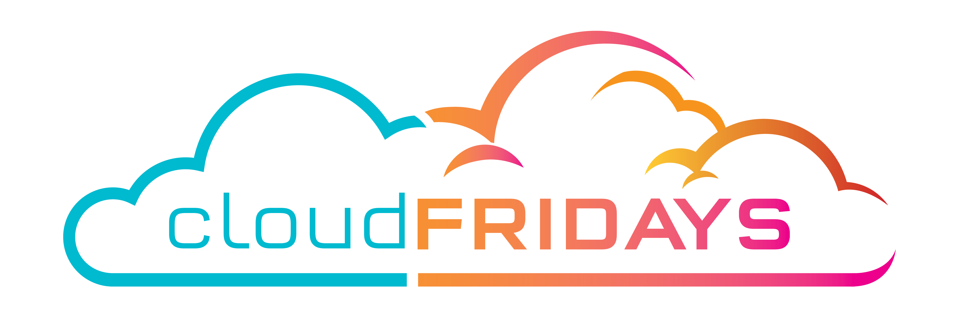

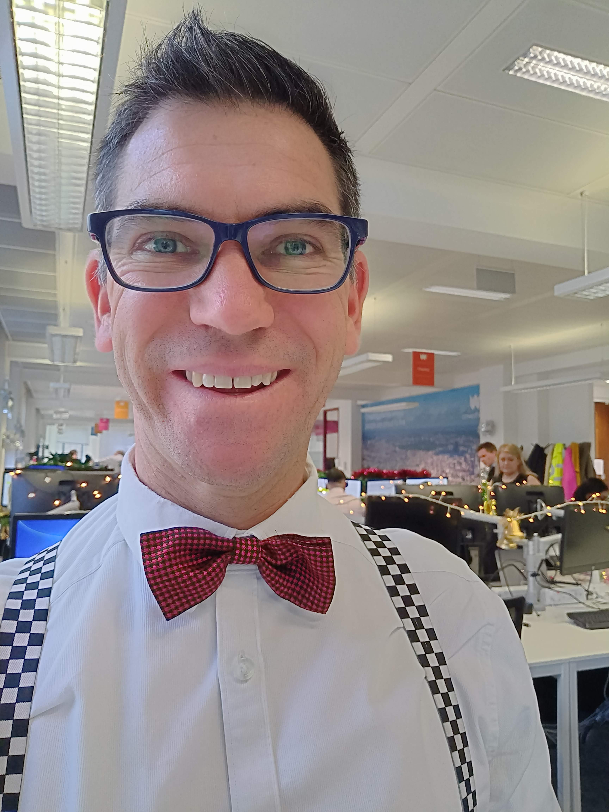

Azure AD Domain Services
@skrods
Matt Levy
Mattchatt.co.za

Slide 2

Identity is the Primary control plane
Notes:
Managing access to apps and data – no longer traditional network security boundaries because CLOUD is the destination.

Slide 3
Choose the right authentication
Don’t take this decision lightly
First decision
Control access
Other advanced security
Changing your authentication method requires planning, testing, and potentially downtime.
Notes:
Authentication method is the first decision for moving to the cloud
Authentication method is critical in controlling access to all cloud data and resources
It’s the foundation of all other advanced security and user experience features

Slide 4
3 Choices
Active Directory
Azure Active Directory
Azure Active Directory Domain Services

Slide 5
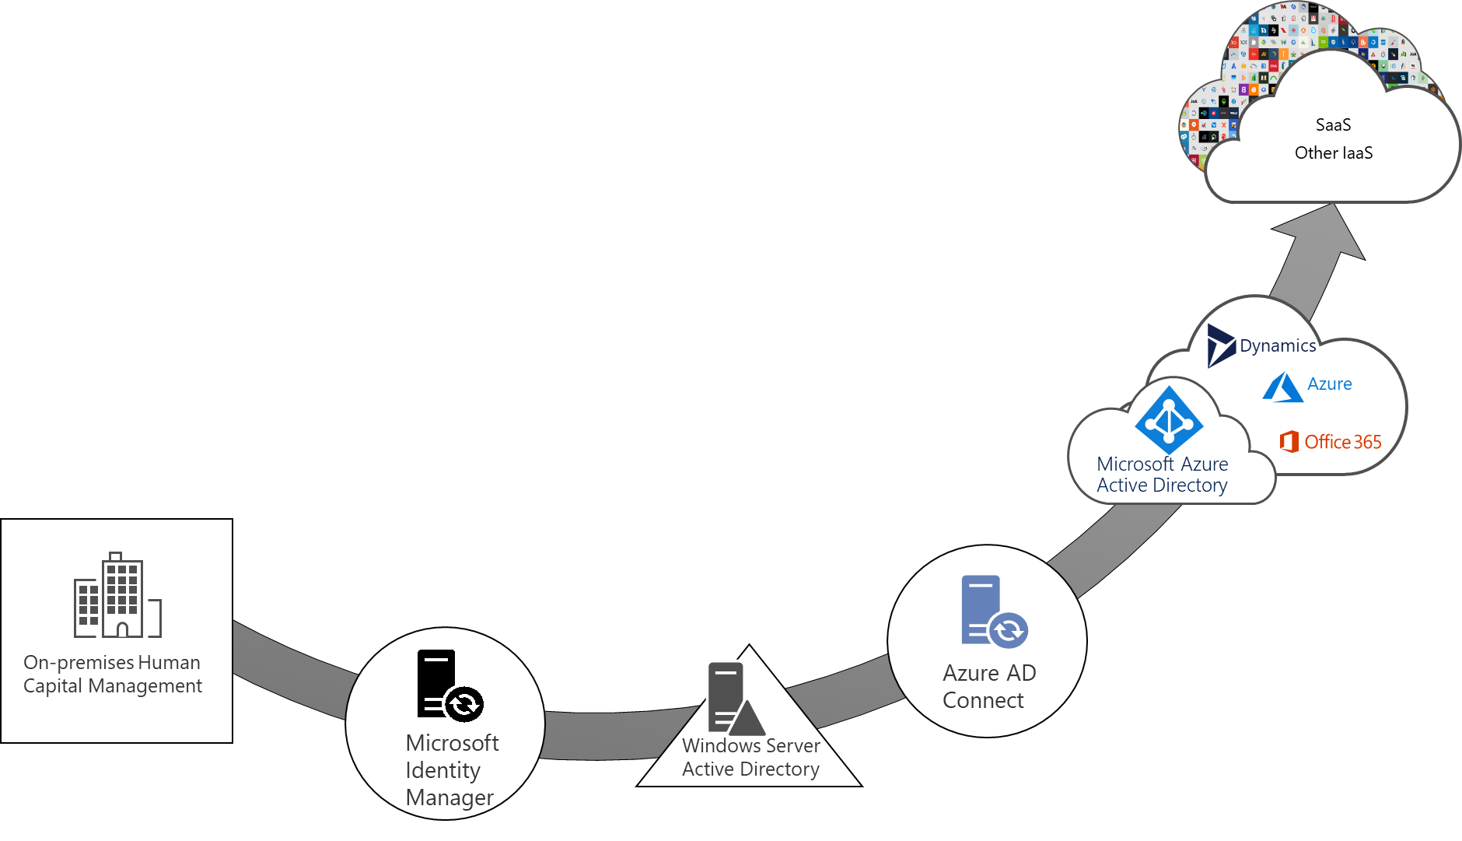
Cloud governed identity management
As organizations transition to the cloud
"Cloud governed management" describes how organizations manage and govern their users, applications, groups, and devices from the cloud.
Notes:
As organizations transition to the cloud, they need assurances that they have controls over their complete environment - more security and more visibility into activities, supported by automation, and proactive insights. "Cloud governed management" describes how organizations manage and govern their users, applications, groups, and devices from the cloud.

Slide 6
Active Directory (AD DS)
AD DS
Users and computers
DNS
Group Policies
LDAP
Kerberos
NTLM
OUs
Trusts
LDAP server that provides authentication, object management, group policies, trusts and DNS
100% your responsibility.

Slide 7

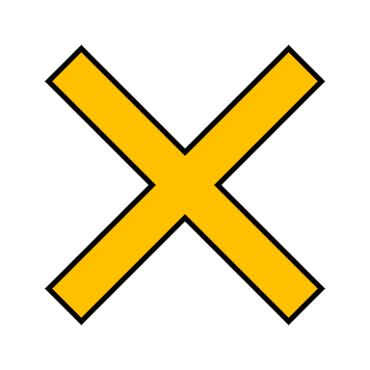
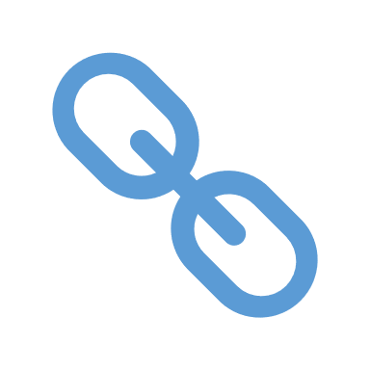
Azure Active Directory (AAD)
AAD
Users and Groups
Apps
SSO
B2B
RBAC
Devices
Conditional Access
OAuth2
SaaS
LOB
Mobile
Windows
AD DS
Users and computers
DNS
Group Policies
LDAP
Kerberos
NTLM
OUs
Trusts
AAD is Microsoft’s cloud-based identity and access management service, which helps your employees sign in and access resources
Compare Active Directory to Azure Active Directory
Notes:
Click 1 – No OU structure
Click 2 – No DNS (really)
Click 2 – No Group Policies (There is management of devices using Intune for example but not the granularity of GPOs)
Click 4 – Legacy authentication protocols
Click 5 – Trusts to partner domains, etc.
AAD uses modern authentication protocols (such as Oauth, SAML or OpenID Connect) SAML = Security Assertion Markup Language

Slide 8

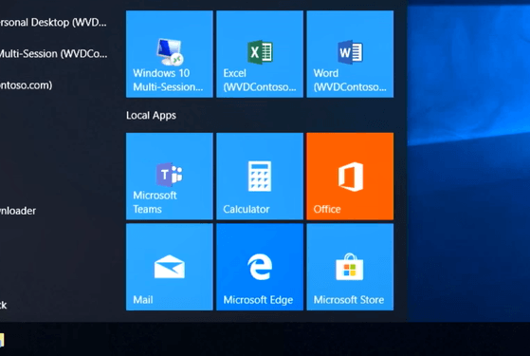
WVD won’t work with AAD
Notes:
WVD Session hosts need to be Domain Joined and use Kerberos authentication

Slide 9
WVD with AD DS

Slide 10
You COULD extend AD into Azure

Slide 11
Azure Active Directory Domain Services (AAD)
AAD
Users and Groups
Apps
SSO
B2B
RBAC
Devices
Conditional Access
OAuth2
SaaS
LOB
Mobile
Windows
Continuous 1-way sync
AAD Connect
Provides managed domain services with a subset of fully-compatible traditional AD DS features such as domain join, group policy, LDAP, and Kerberos / NTLM authentication.
AD DS
Users and computers
DNS
Group Policies
LDAP
Kerberos
NTLM
OUs
Trusts
AAD DS
Users and computers
DNS (managed)
Group Policies
LDAP
Kerberos
NTLM
OUs
Trusts*
PHS
#
#
Notes:
Azure AD DS integrates with Azure AD, which itself can synchronize with an on-premises AD DS environment. This ability extends central identity use cases to traditional web applications that run in Azure as part of a lift-and-shift strategy.

Slide 12
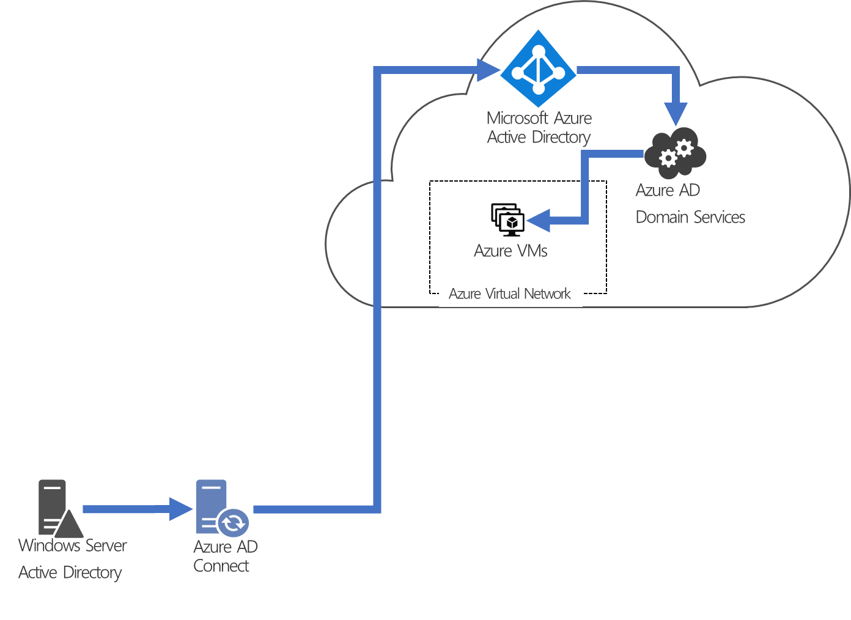

Slide 13
DEMO AAD DS

Slide 14
Questions
Is it highly available?
How do you administer AAD DS?
Is there Disaster management for AAD DS?
What about Trusts?
Do I need to backup the domain controllers?
Can I move my AAD DS to another subscription or tenant?
Why would we go AD>AAD>AADDS?
Notes:
Backups happen automatically every 1-14 days
Synchronization happens ~daily but the number of objects dictates how long it takes to sync.
Trusts - A resource forest uses a one-way outbound trust from Azure AD DS to one or more on-premises AD DS environments.
AD>AAD>AADDS is part of the journey to remove on-prem footprint. For apps that need LDAP/Kerberos. Eventually you can remove the on-prem AD. If you are “cloud first” you would remain AAD>AADDS.

Slide 15
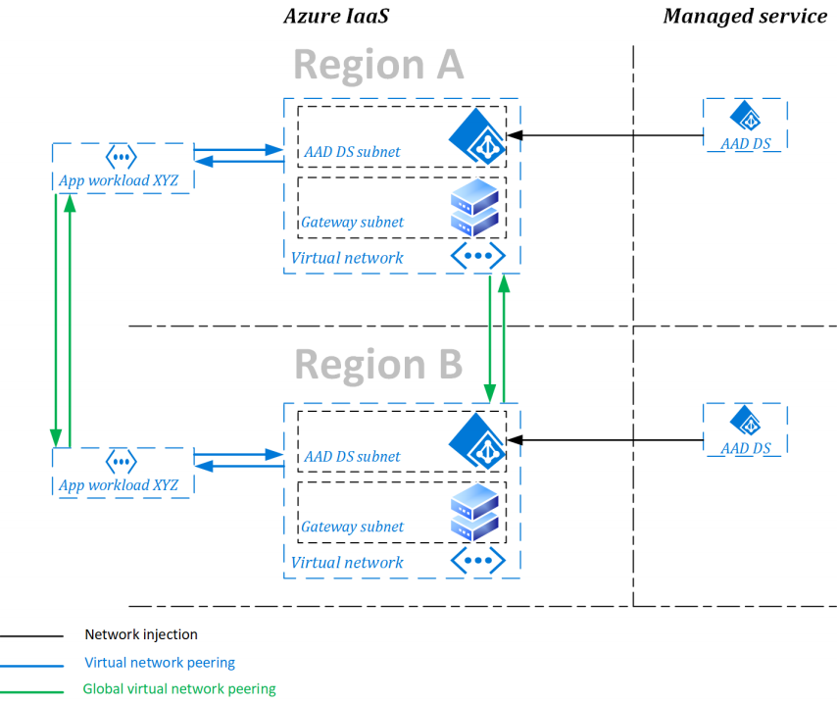
Replica Sets

